Slide 1
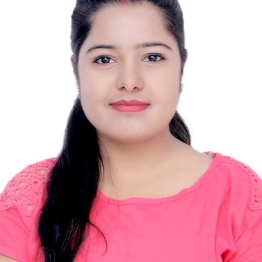

Prajakta Vajanam
Analyst/Software Engineer
Bachelor of Engineering , Computer Science Engineering : 2016 - 2020
Skills
C# | C# Basics, OOPS, Exception Handling, Collections & Generics, Delegates, Events, File IO and Serialization
.NET Framework | Architecture which includes CTS,CLS, FCL, BCL and CLR
ADO.NET | Basics, Connected and Disconnected architecture
RDBMS | Basic and advanced using SOL Server
Python | Core Python, Basics of Advanced Python, Project Using Python Programming
Java | Core And Advanced Java
Add On skills | Communication, Team Management
Mumbai
Prajakta.vajanam@capgemini.com
+918007249925
A4
Practical Understanding of RDBMS concepts using SQL server
Hands on Experience in developing applications using .NET Framework, ADO.NET, SQL Server
Practical Knowledge of ASP.Net core with entity Framework
Understanding of HTMAL, CSS & JAVASCRIPT
Microsoft AZ-900 Certification
Microsoft AZ-104 Certification
Microsoft AZ-204 Certification
Successfully completed ADAPT Training: RDBMS, C#, DOTNET, with70%
Completed soft skill courses on Coursera : Successful Presentations, Write Professional Emails, Communication Strategies for Virtual Age
Successfully completed Agile Software Development course from Coursera
Railway Reservation System: Case study of railway reservation system along with SQL as backend, .Net core web API using Swagger as middleware and Angular as Frontend. Used HTML, CSS, Typescript for designing.
Check out my work on GitHub

